Slide 1


Elastic COMPUTE SYSTEM

Slide 2
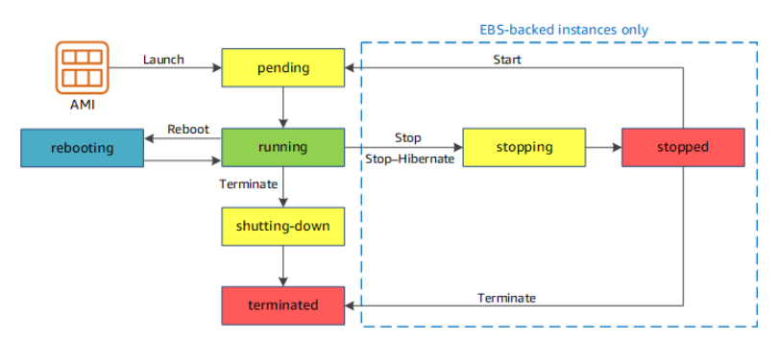
Instance life cycle
https://docs.aws.amazon.com/AWSEC2/latest/UserGuide/ec2-instance-lifecycle.html

Slide 3
instances

Slide 4
Instance bootstrapping
Shell Scripts
Options
At instance launch
At instance bootup every time
Run as Root
Check logs in /var/log/cloud-init-output.log
Copied in /var/lib/cloud/instances/instance-id/
Cloud Init directives
Advanced -> Cloud Formation
https://docs.aws.amazon.com/AWSEC2/latest/UserGuide/user-data.html

Slide 5
Instance special detail url
http://169.254.169.254/latest/meta-data/
TOKEN=`curl -X PUT "http://169.254.169.254/latest/api/token" -H "X-aws-ec2-metadata-token-ttl-seconds: 21600"` \
&& curl -H "X-aws-ec2-metadata-token: $TOKEN" -v http://169.254.169.254/

Slide 6
Instance special detail url
practical
Get security-groups and hostname

Slide 7
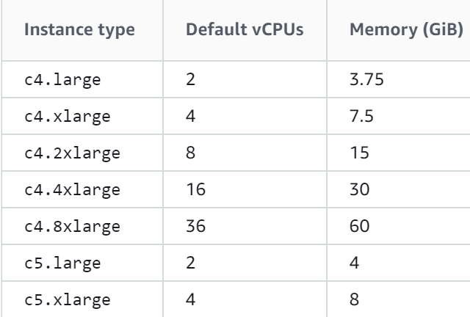
Instance types - cpu
Batch processing workloads
Media transcoding
High-performance web servers
High-performance computing (HPC)
Scientific modeling
https://docs.aws.amazon.com/AWSEC2/latest/UserGuide/compute-optimized-instances.html

Slide 8
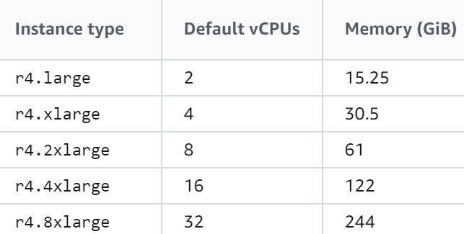
Instance types - memory
High-performance, relational (MySQL) and NoSQL (MongoDB, Cassandra) databases.
Distributed web scale cache stores that provide in-memory caching of key-value type data (Memcached and Redis).
Applications performing real-time processing of big unstructured data (financial services, Hadoop/Spark clusters).

Slide 9
Instance types - optimized
M5, M5a, M5ad, M5d, M5dn, and M5n Instances
T2, T3, and T3a Instances
Websites and web applications
Code repositories
Development, build, test, and staging environments
Microservices
Web and application servers
Small and medium databases
Gaming servers
Caching fleets
Running backend servers for SAP, Microsoft SharePoint, cluster computing, and other enterprise applications

Slide 10
Ec2 launch templates

Slide 11
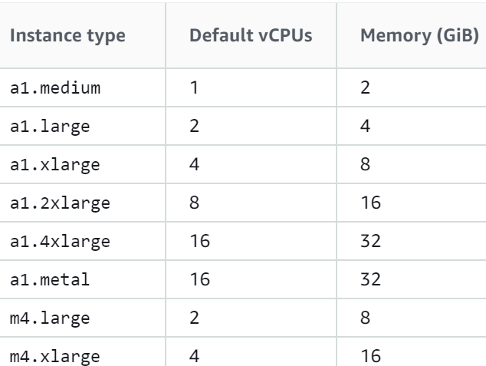
Instance types - optimized

Slide 12
Ec2 spot requests

Slide 13
Ec2 saving plan

Slide 14
Ec2 reserved instances

Slide 15
Ec2 dedicated hosts

Slide 16
Ec2 scheduled instances

Slide 17
Ec2 capacity reserved

